Slide 1
Amazon Book Recommendation And Text Analysis of Reviews
By:
Freddy Daruwala
Gautam Pawar
Nikita Anand
Tapadyuti Maiti

Slide 2
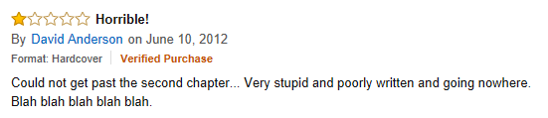
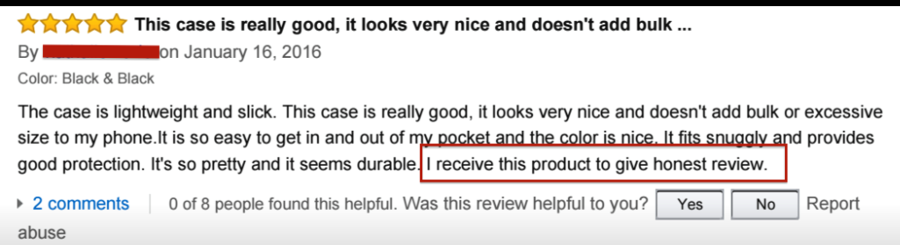
Reviews Like This???

Slide 3
Business Case
Our case study is from the Publisher’s point of view
Improve customer reviews from the reviewers
Make the reviews helpful for other customers
Find techniques to recommend the best seller items after getting improved ratings

Slide 4
Problem Statement

Slide 5
For Reviews Like This…
We came up with the algorithm to authenticate the reviews as
Incentivized/Non-Incentivized Reviews Using NLP

Slide 6
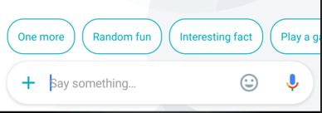
For Reviews Like this…
Positive and
Negative reviews using
LDA and K-Means Clustering

Slide 7
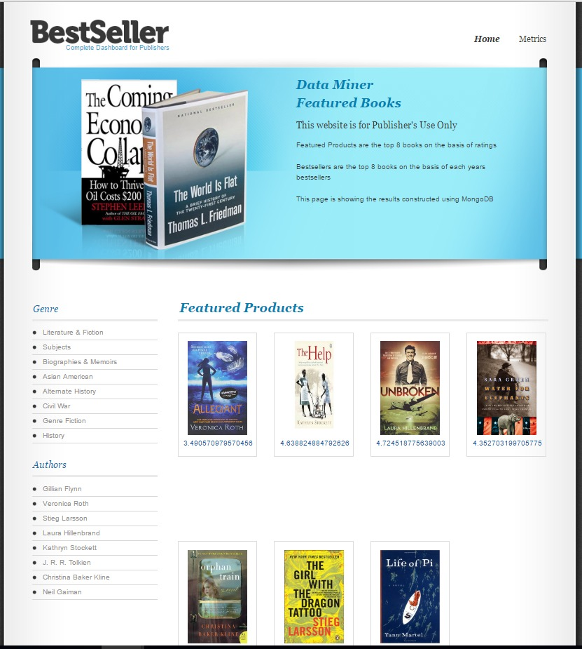
Let’s Recommend What is The Best

Slide 8
Clean The Data

Slide 9
Dataset Information
Amazon Book and User recommendation
Format: JSON
Source: https://snap.stanford.edu/data/web-Amazon.html
7 million records (train dataset)
2 million records (test dataset)
Text Analytics using NLP and LDA
2 million records
Data Visualization
1,50,000 records

Slide 10
Techniques Used to Clean Data
MapReduce
We used a series of mapper and reducers to derive the required features from data
In the first set of mappers and reducers we are removing the duplicity in the data and removing the data points that are incomplete and would be inconsequential to our analysis.
In the second set of mappers and reducers we are obtaining the data inputs in order to run the Mahout recommender engine.
R using data.table and dplyr packages.

Slide 11
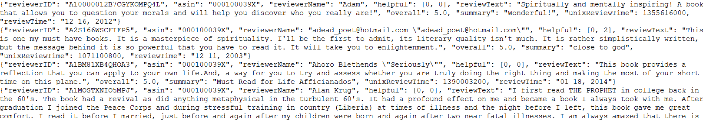
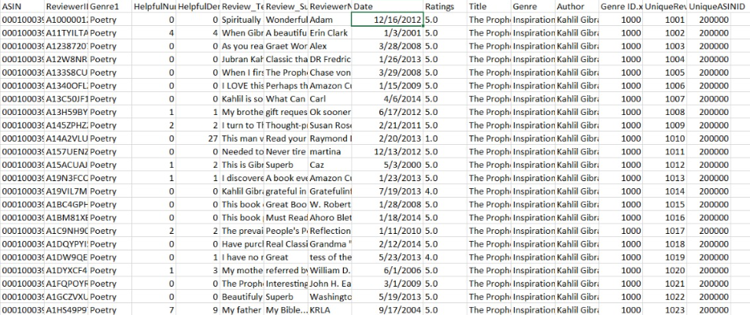
Datasets before and After Cleaning

Slide 12
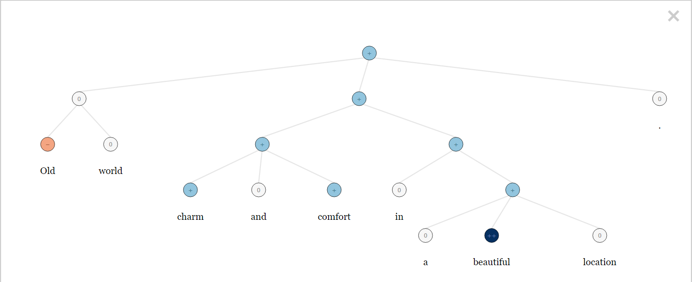
Text Analytics
Used Stanford NLP algorithm to analyze incentivized reviews

Slide 13
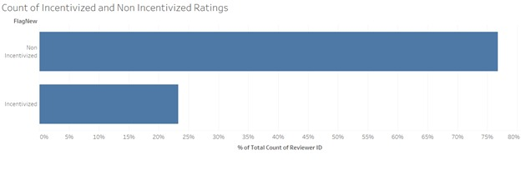
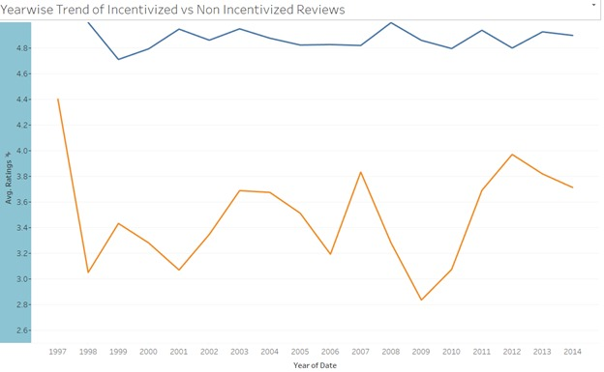
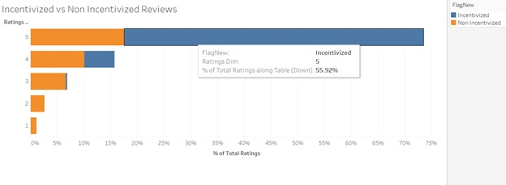
Text Analytics Metrics Using Stanford NLP
Incentivize and Non-Incentivize
Reviews

Slide 14

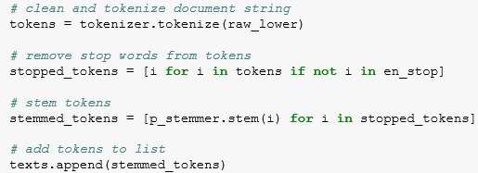

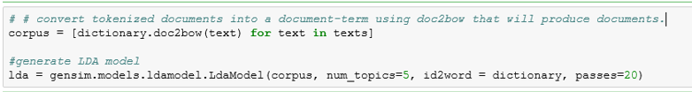
Topic Modeling using LDA
Used Latent Dirichlet Allocation to divide the review data into topics and describe the overall structure of a particular book.
Used libraries nltk.tokenize , get_stop_words to clean the review data in python.
Used gensim library to build the Lda Model

Slide 15
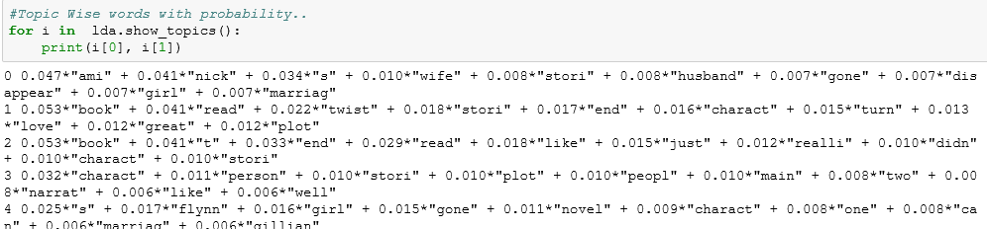
Analyzing Results:
We can see the topic wise distribution of the review data.
Topics – Story and Critics
Analyzing the topic distribution in each document.
Document | Topic
D1 | Story50% Critics 50%
D6 | Story90% Critics 0%

Slide 16
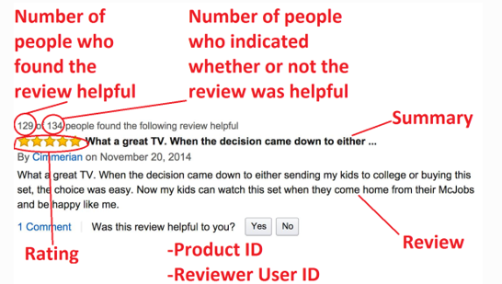
Text Analytics using K-means Clustering
Helpfulness Numerator: Number of people who found the review helpful.
Helpfulness Denominator: Number of people who indicated whether review was helpful or not.
Helpfulness = 1 if Helpfulness Numerator/ Helpfulness Denominator >0.5 else 0
Cleaned the data by removing stop words and tokenizing.
Clustered the review text into 4 clusters and found out the top 10 words per cluster.

Slide 17

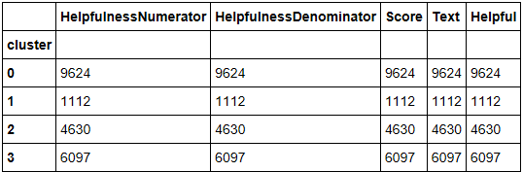
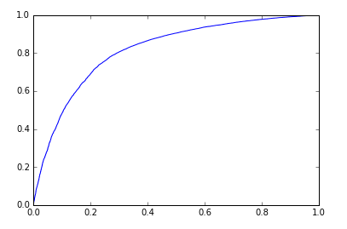
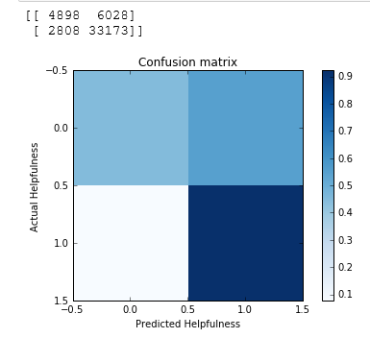
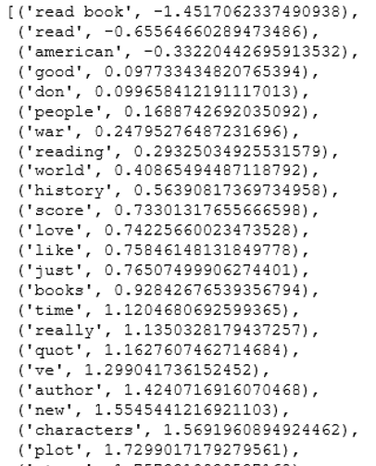

Next , we will sort the cluster values and get the top 10 cluster values
Getting the top words with their estimated coefficients. Words with positive coefficients correlate to helpful review while negative to the unhelpfulness.

Slide 18
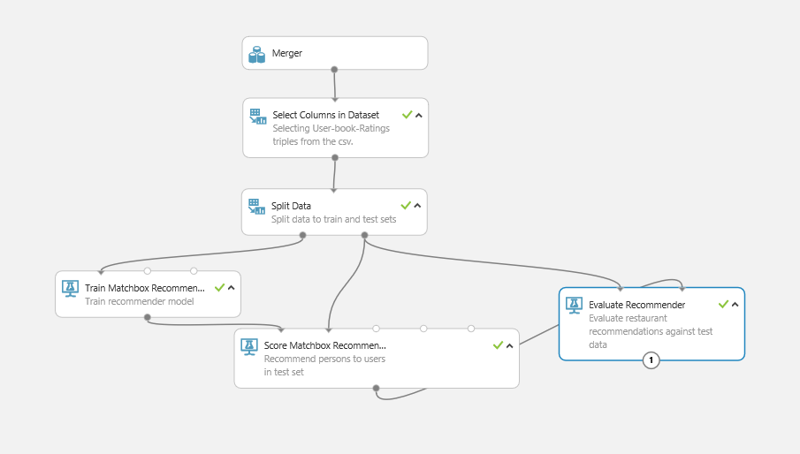
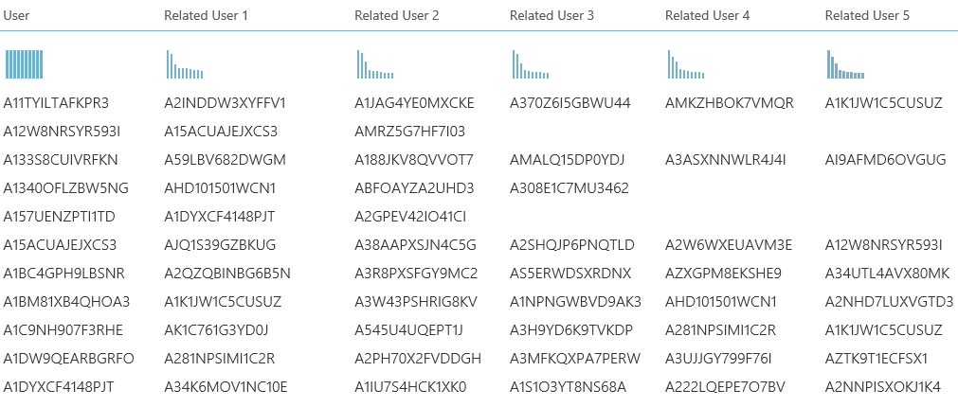
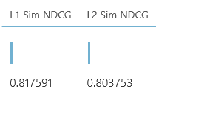
Person Recommendation using Matchbox Algorithm
Matchbox Recommendation algorithm combines collaborative filtering with a content-based approach called as Hybrid approach.
Normalized discounted cumulative gain (NDCG)

Slide 20
Data Analysis Using Tableau
Distribution of Ratings over the reviews.
Year wise Reviews analysis.
Rating wise Helpfulness analysis.
Genre Based Ratings analysis

Slide 21
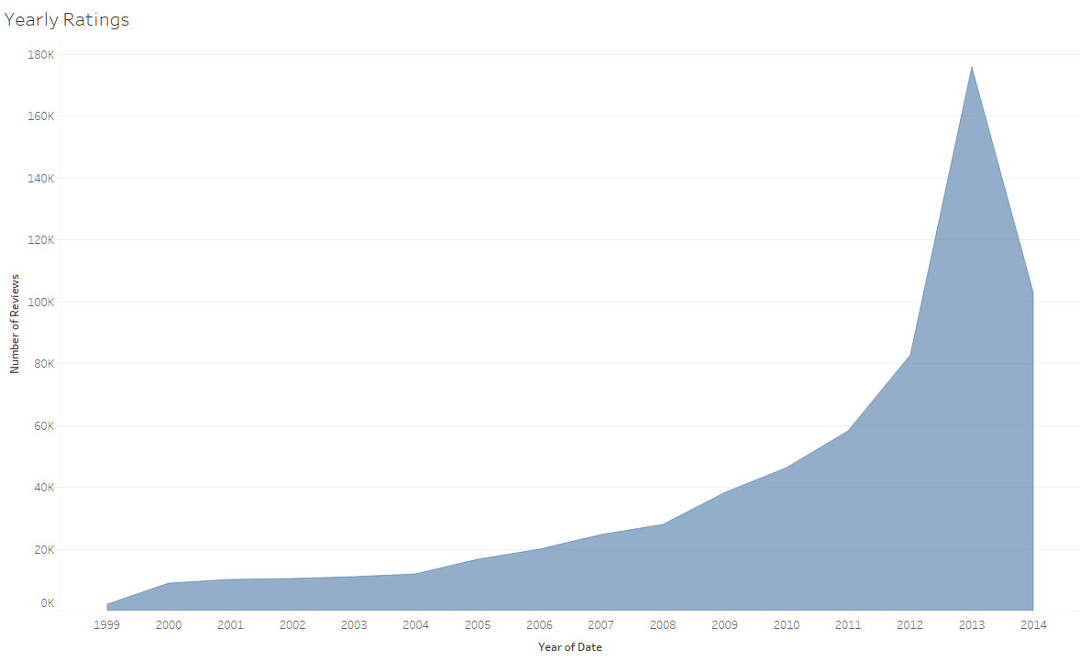
Year wise Reviews Analysis

Slide 22
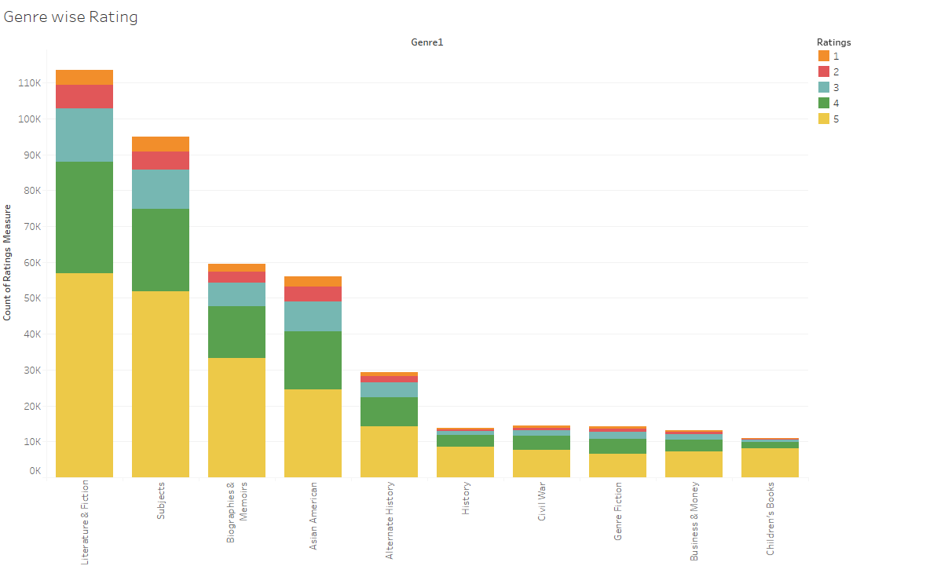
Genre Based Ratings

Slide 23
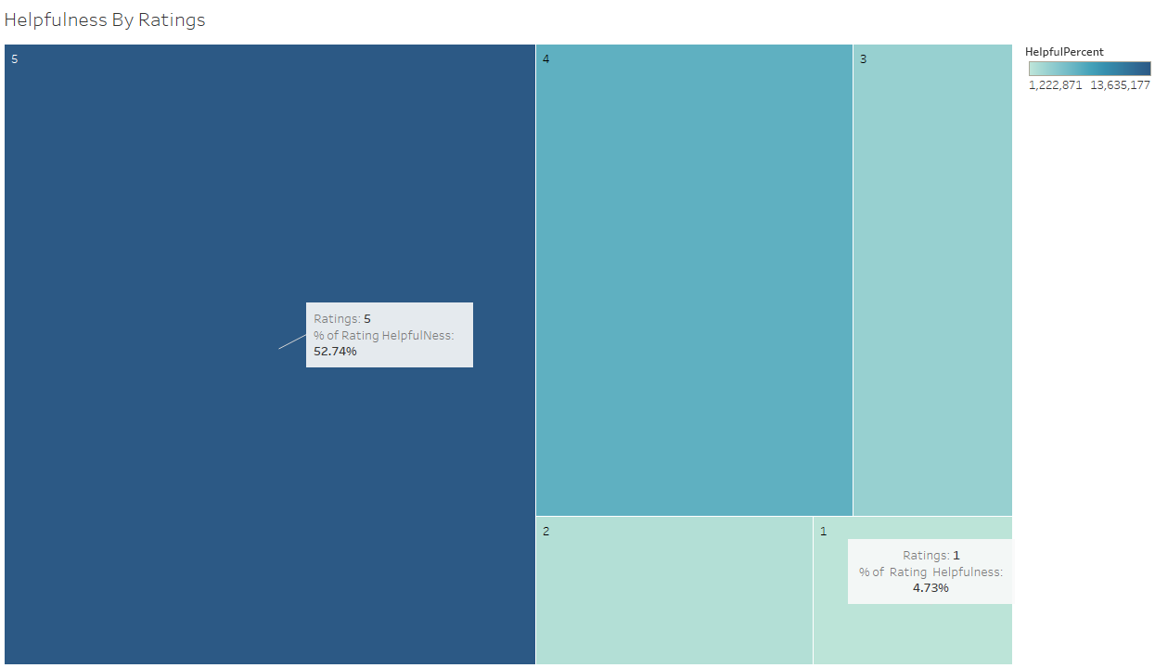
Helpfulness by Ratings

Slide 24
Application Development
Used MongoDB server to store data and display on the front end.
Integrated MongoDB with java spring MVC.
Restful API using azure to get real time data.

Slide 25
Thank you & Questions!!

